Slide 1
Autism Classification in Individuals
Team 3
Bhakti Jayesh Raichura
Khushee Subash Thakker
Shreya Srirama
Varsha Srinivasan

Slide 2
CONTENTS OF THE PRESENTATION
Data Summary
03
04
Data Pre-Processing
Literature Survey
02
05
Data Models
Objective and Motivation
01
06
Feature Selection
07
Comparison and Conclusion

Slide 3
OBJECTIVES
Building Classification Models like Multinomial Naive Bayes, Logistic Regression, Random Forest and Decision Tree Classifiers
Determining the characteristic that most predicts autism in people
Rapid ASD screening to ascertain whether clinical diagnosis is required
Machine learning models aid in autism diagnosis, facilitating timely intervention and prevention

Slide 4


MOTIVATION
1
3
5
Adult autism detection is crucial for social and socioeconomic factors.
Benefits include improved reliability and efficiency for healthcare professionals
Uncovering subtypes of ASD using demographic and behavioral data
Early autism diagnosis in adults, aids in improved outcomes and quality of life
Improved individualized treatment choices for people with ASD
2
4

Slide 5
LITERATURE REVIEW
Paper Name | Author | Publication | Year
Machine learning in autistic spectrum disorder behavioral research: A review and ways forward | Fadi Thabtah | Informatics for Health and Social Care | 2019
Comparison of classification algorithms for predicting autistic spectrum disorder using WEKA modeler | Siti Fairuz Mohd Radzi, Mohd Sayuti Hassan & Muhammad Abdul Hadi Mohd Radzi | Springer Nature- BMC Medical Informatics and Decision Making | 2022
Analysis and Detection of Autism Spectrum Disorder Using Machine Learning Techniques | Suman Raj, Sarfaraz Masood | Science Direct | 2020
Performance Analysis of Machine Learning Classifiers for ASD Screening, | A. S. Halibas, L. B. Reazol, E. G. T. Delvo and J. C. Tibudan, | International Conference on Innovation and Intelligence for Informatics, Computing, and Technologies (3ICT) | 2018
Prediction of Autism Spectrum Disorder using Random Forest Classifier in Adults, | A. Kanchana and R. Khilar | IEEE | 2022

Slide 6
DATA SOURCE
SOURCE: UCI Machine Learning Repository
The dataset consists of 704 records, each with 20 features
The dataset was collected through an online survey and includes data from individuals from various countries, including the United States, Canada, and the United Kingdom
The screening questions were based on the Autism Spectrum Quotient (AQ) and the Ritvo Autism and Asperger Diagnostic Scale (RAADS-R)
10 BEHAVIOURAL FEATURES
Based on Autism Spectrum Quotient (AQ10 )
SCORING: Only 1 point can be scored for each question.
10 INDIVIDUAL CHARACTERISTICS
Features like Age, Gender, Ethnicity

Slide 7
INDIVIDUAL FEATURES
Attribute | Type | Description
Age | Number | Age in years
Gender | String | Male or Female
Ethnicity | String | List of common ethnicities in text format
Born with jaundice | Boolean (yes or no) | Whether the case was born with jaundice
Family member with PDD | Boolean (yes or no) | Whether any immediate family member has a PDD
Who is completing the test | String | Parent, self, caregiver, medical staff, clinician ,etc.
Country of residence | String | List of countries in text format
Used the screening app before | Boolean (yes or no) | Whether the user has used a screening app
Screening Method Type (Type of screening method chosen based on age category) | Integer (0,1,2,3) | The type of screening methods chosen based on age category (0=toddler, 1=child, 2= adolescent, 3= adult)
Screening Score | Integer | The final score was obtained based on the scoring algorithm of the screening method used. This was computed in an automated manner

Slide 8
BEHAVIOURAL FEATURES
Attribute | Type | Description
I often notice small sounds when others do not | (0,1) | Answer code of the question based on screening method
I usually concentrate more on the whole picture, rather than the small details | (0,1) | Answer code of the question based on screening method
I find it easy to do more than one thing at once | (0,1) | Answer code of the question based on screening method
If there is an interruption, I can switch back to what I was doing very quickly | (0,1) | Answer code of the question based on screening method
I find it easy to ‘read between the lines’ when someone is talking to me | (0,1) | Answer code of the question based on screening method
I know how to tell if someone listening to me is getting bored | (0,1) | Answer code of the question based on screening method
When I’m reading a story I find it difficult to work out the characters’ intentions | (0,1) | Answer code of the question based on screening method
I like to collect information about categories of things (e.g. types of car, types of bird, types of train, types of plant etc) | (0,1) | Answer code of the question based on screening method
I find it easy to work out what someone is thinking or feeling just by looking at their face | (0,1) | Answer code of the question based on screening method
I find it difficult to work out people’s intentions | (0,1) | Answer code of the question based on screening method

Slide 9
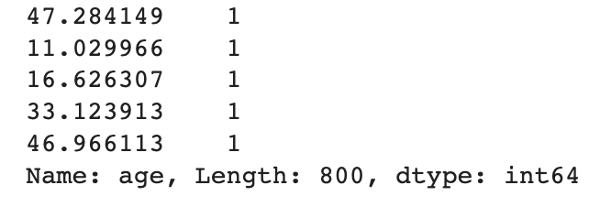
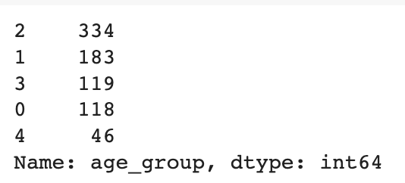
DATA PREPROCESSING
Convert from .arff to .csv
Dropping irrelevant columns like ID, age_desc
Correcting columns names ( austim -> autism , contry_of_res - country_of_res)
Performed data cleaning by replacing ‘?’ as ‘others’
Data Discretization - Converted continuous feature ‘age’ into multiple age groups
Notes:
Age_desc had only 1 value for all the instances hence dropped
Age_group
0 - child (<13)
1 - adolescent (<21)
2 - adult (<40)
3 - middle aged (<60)
4 - elderly (>60)

Slide 10
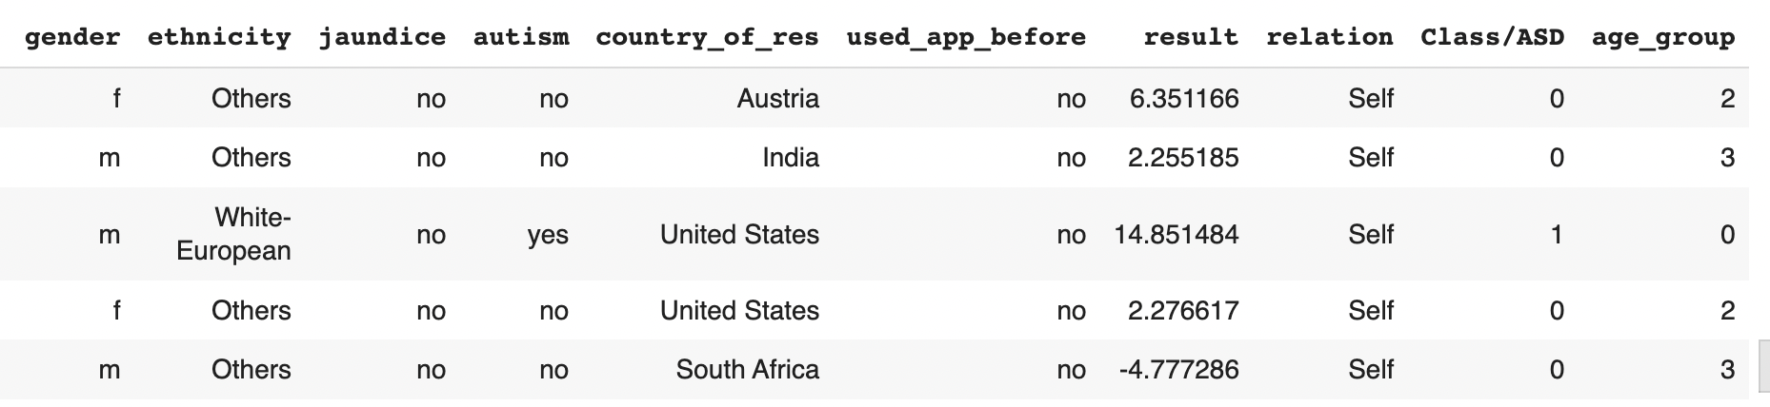
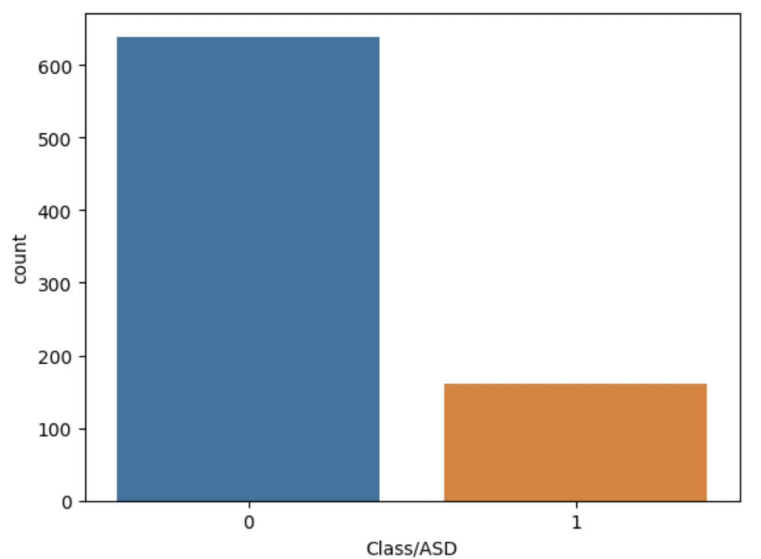
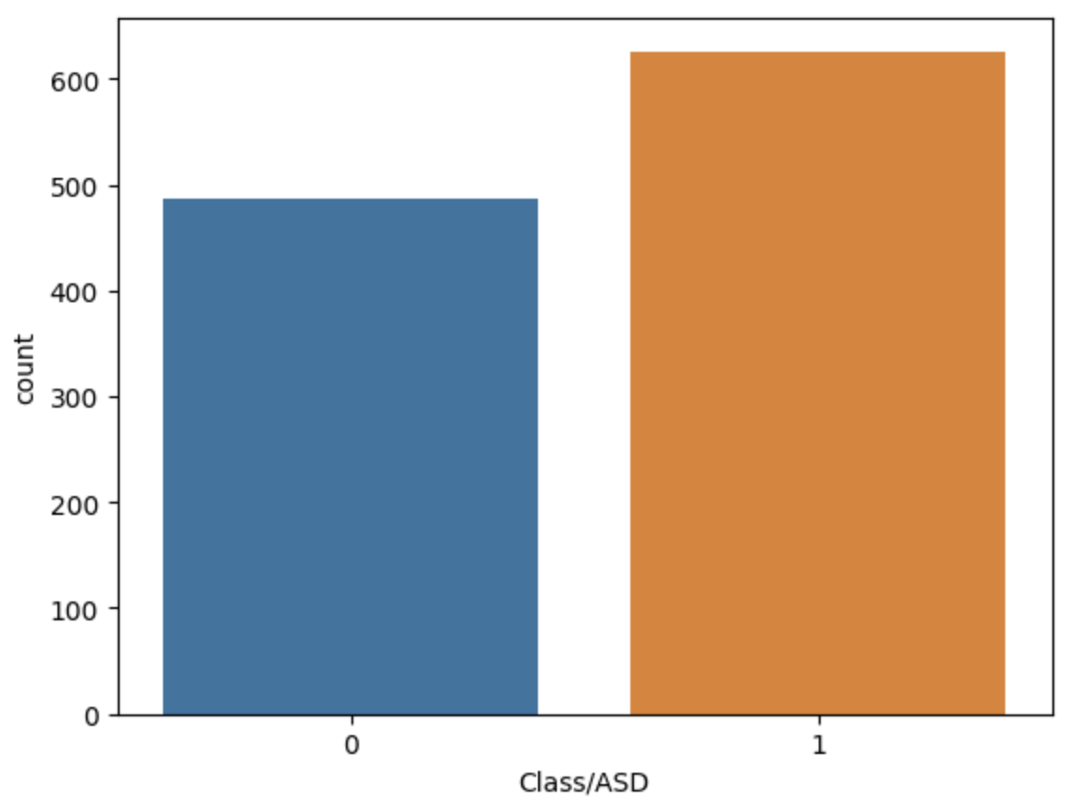
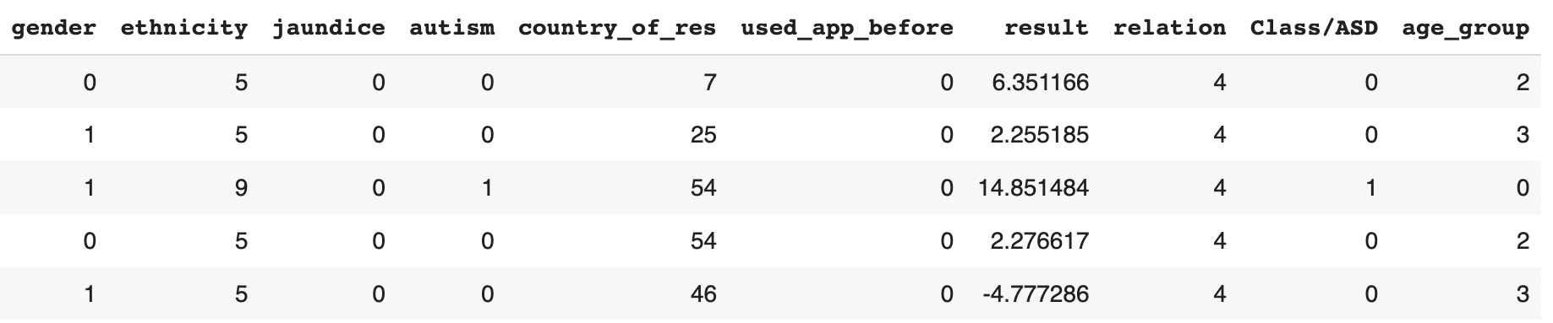
DATA TRANSFORMATION
LABEL ENCODING AND NORMALIZATION
UNBALANCED DATA
SMOTE : Over-sampling
Edited Nearest Neighbour(ENN): Under-sampling/cleaning
SMOTEENN
Using MinMax Scalar

Slide 11
DATA MODELS
1
Multinomial Naive Bayes
Finite set of discrete input for Q&A
2
Decision Tree Classifier
Understandability & Interpretability
3
Random Forest Classifier
Parametric approach - suitable for binary classification, inbuilt optimizer & regularization term
4
Logistic Regression

Slide 12
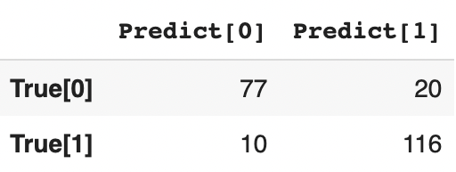
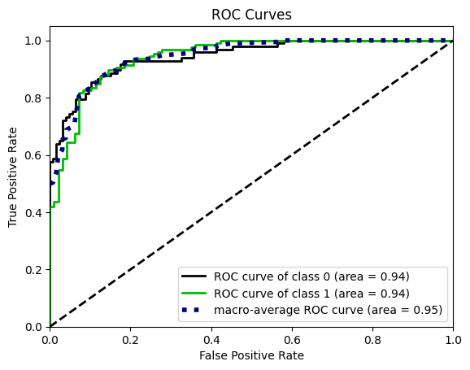
Without Feature Selection
Multinomial Naive Bayes
Accuracy | 0.8654
Recall | 0.9206
Precision | 0.8529
FNR | 0.07

Slide 13
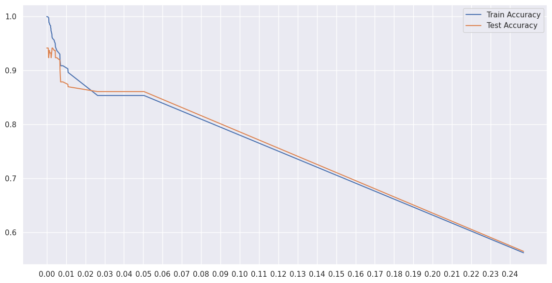
2. Decision Tree Classifier
Caused overfitting with Training accuracy 100% and Testing accuracy 93%
So we performed tree pruning using cost complexity function.
Plot of multiple appropriate ccp_alpa against train & test accuracy
To find ccp_alpha where train and test accuracy is high and similar to each other
Hence we selected ccp_alpha = 0.00520667
Accuracy
ccp_alpha

Slide 14
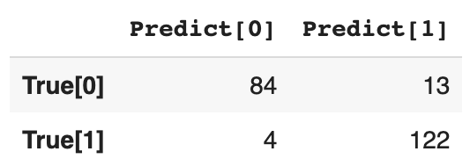
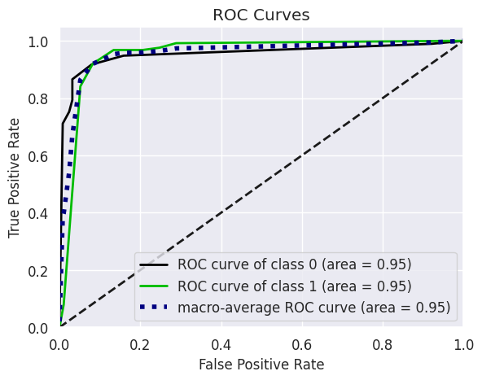
2. Decision Tree Classifier
Accuracy | 0.9237
Recall | 0.9282
Precision | 0.9037
FNR | 0.0317

Slide 15
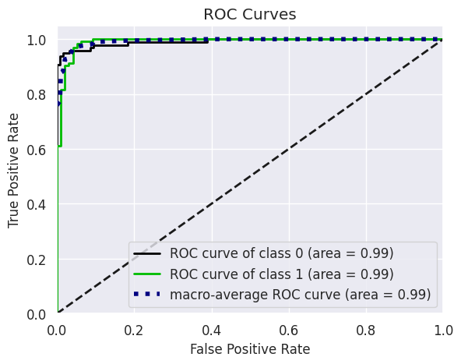
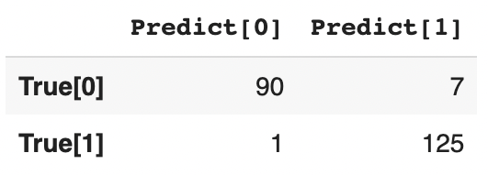
3. Random Forest Classifier
Caused overfitting with Training accuracy 100% and Testing accuracy 97%
So based on the knowledge on prior pruning, we stopped the tree growth by limiting max_depth to 7
Accuracy | 0.9641
Recall | 0.9920
Precision | 0.9469
FNR | 0.0079

Slide 16
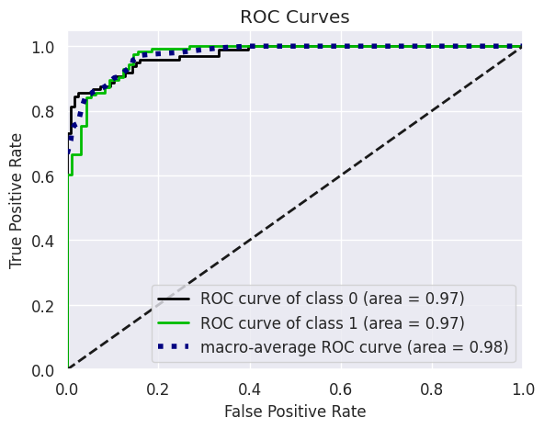
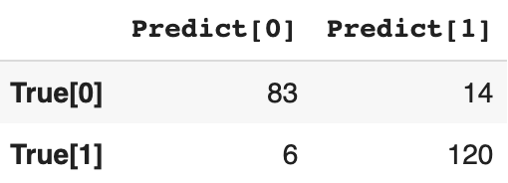
4. Logistic Regression
No overfitting as both Training and Testing accuracy was 91%
Accuracy | 0.9103
Recall | 0.9523
Precision | 0.8955
FNR | 0.0476

Slide 17
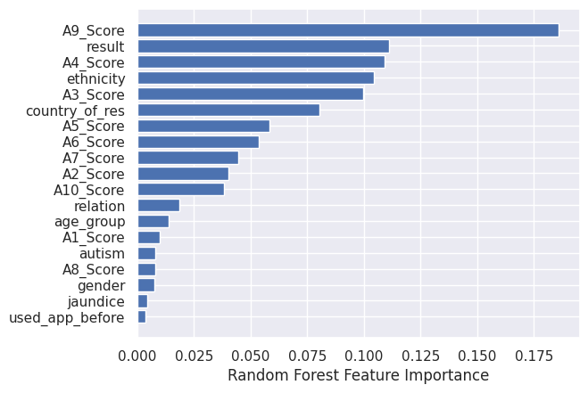
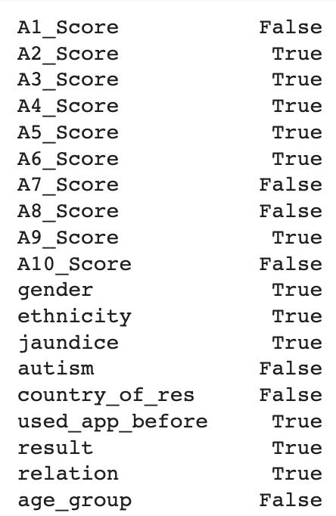
Feature Selection Methods
Feature Importance by
Random forest
90% Confidence Interval
p-value

Slide 18
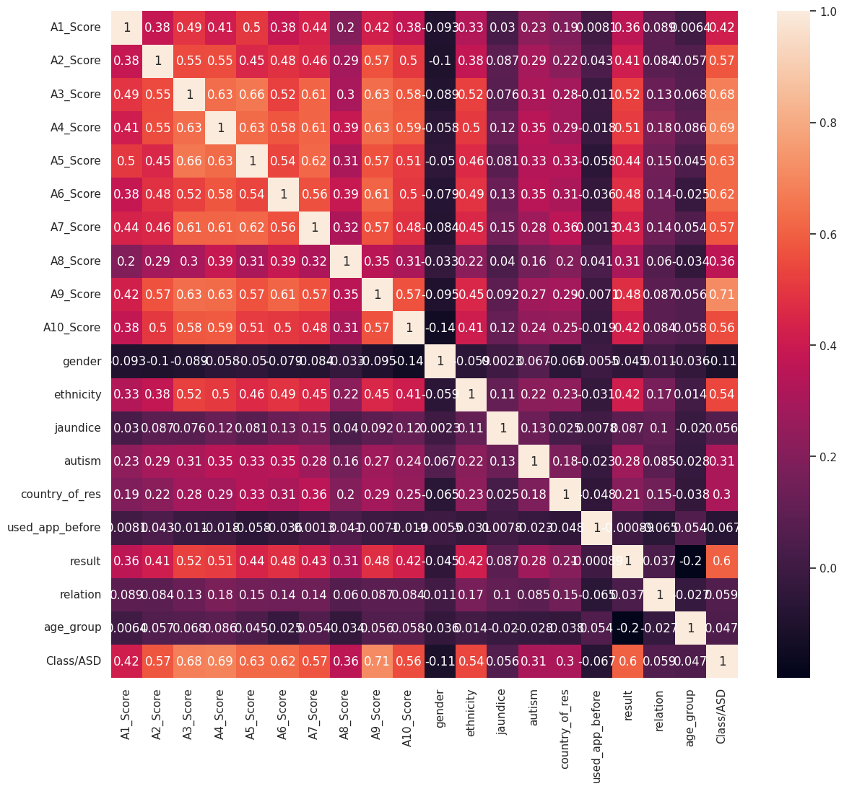
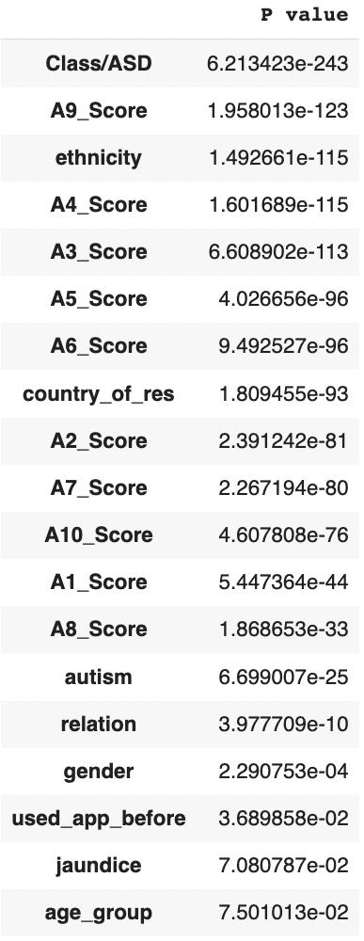
Correlation Matrix
Chi^2 value wrt target variable

Slide 19
3 & 2 Common features found as least important
Correration | Feature Imp | odds ratio | Chi square
Age_group | used_app_before | A1_score | Age_group
Jaundice | Jaundice | A7_score | Jaundice
relation | gender | A10_score | used_app_before
used_app_before | Autism | Autism | gender
 |  | Country
 |  | Age_group
Age_group - To be dropped
Used_app_before - To be dropped
Jaundice - Important feature
Article by Reuters states that children born with jaundice had 56% greater chance to develop ASD
Gender - To be dropped
A research by May, T., Cornish, K. & Rinehart, N (2014) concluded that no gender differences
Autism ( family member ) - Important feature
Centers of Disease Control and Prevention mentions that a individual is more likely to have developed ASD if ASD is present in their family health history.
Notes:
Jaundice - children born full-term with jaundice had a 56 percent greater chance of developing an autistic spectrum disorder later on than those without jaundice, report the researchers in the journal Pediatrics
Gender - The authors have conducted a one year research on Does gender matter for ASD? And why more males than females are diagnosed with ASD. And their findings were Males were more hyperactive and received more integration-aide support. Whereas Lower hyperactivity levels in females might contribute to their under-identification. Hence concluded that no gender differences is present in autistic symptoms.

Slide 20
Result Comparison With Feature Selection
 | Models | MNB | DT | RF | LR
Without Feature Selection | Accuracy | 0.86 | 0.93 | 0.96 | 0.92
 | FNR | 0.07 | 0.03 | 0.007 | 0.04
With Feature Selection | Accuracy | 0.89 | 0.93 | 0.96 | 0.91
 | FNR | 0.04 | 0.03 | 0.007 | 0.03

Slide 21
Best Model for Prediction
 | Random Forest | Multinomial Naive Bayes | Decision Tree | Logistic Regression
Accuracy | 0.96 | 0.89 | 0.93 | 0.91
FNR | 0.007 | 0.04 | 0.03 | 0.03
Specificity | 0.927 | 0.86 | 0.81 | 0.84
Highest Accuracy score 96%
Lowest False Negative Rate detected only 1 w
rong out of 126
Dealing with the classification of a medical condition, we have decided to set our target metric as Specificity. Random forest has the highest Specificity; 92%

Slide 22
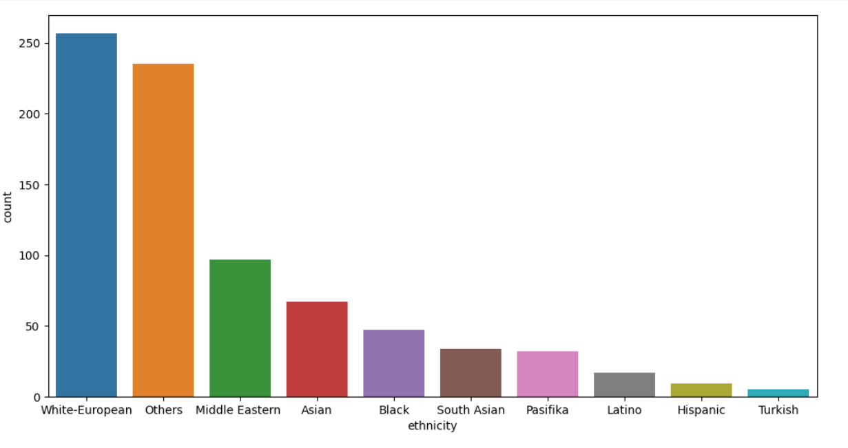
Extracted knowledge of Autism Screening Disorder Dataset
Risk factors:
By analyzing the data, we identified potential risk factors for autism in adults, such as jaundice, ethnicity, family history, and other behavioral questions
Jaundice detected in newborns
Autism in immediate family members
Ethnicity ethnic or racial background
Result Score based on scoring algorithm

Slide 23
Conclusion
Machine Learning Models
Help to predict the likelihood of having autism
Random Forest
Early Prediction
RF showed the best results with highest accuracy
Beneficial in an individual's treatment, which can be carried out by recognizing the risk factors

Slide 24
REFERENCES
Thabtah, F., Abdelhamid, N., & Peebles, D. (2019). A machine learning autism classification based on logistic regression analysis. Health Information Science and Systems, 7(1). https://doi.org/10.1007/s13755-019-0073-5
Raj, S., & Masood, S. (2020). Analysis and Detection of Autism Spectrum Disorder Using Machine Learning Techniques. Procedia Computer Science, 167, 994-1004. https://doi.org/10.1016/j.procs.2020.03.399
Mohd Radzi, S.F., Hassan, M.S. & Mohd Radzi, M.A.H. Comparison of classification algorithms for predicting autistic spectrum disorder using WEKA modeler. BMC Med Inform Decis Mak 22, 306 (2022). https://doi.org/10.1186/s12911-022-02050-x
A. Kanchana and R. Khilar, "Prediction of Autism Spectrum Disorder using Random Forest Classifier in Adults," 2022 IEEE 4th International Conference on Cybernetics, Cognition and Machine Learning Applications (ICCCMLA), Goa, India, 2022, pp. 242-249, doi: 10.1109/ICCCMLA56841.2022.9989304
A. S. Halibas, L. B. Reazol, E. G. T. Delvo and J. C. Tibudan, "Performance Analysis of Machine Learning Classifiers for ASD Screening," 2018 International Conference on Innovation and Intelligence for Informatics, Computing, and Technologies (3ICT), Sakhier, Bahrain, 2018, pp. 1-6, doi: 10.1109/3ICT.2018.8855759

Slide 25
Thank You
Q & A

